Slide 1
Scale Weight Webinar
By ZLR Fitness

Slide 2
Now, for most of us and especially women when we embark on a fitness journey we tend to fixate on the losing weight part!
Partly because society has taught us that to be healthy, we must be skinny, thin and always be on a diet! WRONG!
Now, let's say we don't fixate on weight for a second and focus on the other bits that matter....
Being healthy!
Creating a healthy mind & body!
Improving your body composition!
Creating a toned physique you can feel your most confident self in!
Feeling strong and confident! It's important to be cautious and remember that no matter how much weight you lose this doesn't mean you are going to be happy AUTOMATICALLY! Especially if you continue to chase a number, it's time to change this mindset!
Let’s take a in depth look in fluctuations & what you can expect when stepping on…

Slide 3
Meals out, Alcohol & impact on scale weight…
As I have said I am all for enjoying your meals out, going to a party or even having a few drinks.
Be aware that these things don't encourage weight loss and can hinder weight loss progress.
As long as it does not become a regular weekly thing where you are always indulging then it won't affect your weight loss goals too much.
Getting a balance on this would be making some smarter choices when having meals out, and even cutting back on how many alcoholic drinks you indulge in.
Now with regards to your weight coming down if you indulge no matter which day this happens it can have an effect on the scales not budging for that week.
This is because meals out cause higher sodium levels. Alcohol is a dehydrator, and this can also have an effect. You may wake up and feel flat but remember you are dehydrated! Try to bear these factors in mind next time you step on has they all have an effect!

Slide 4
Stress and the impact it has on weight….
Cortisol can help control blood sugar levels, regulate metabolism, help reduce inflammation, and assist with memory formulation. It has a controlling effect on salt and water balance and helps control blood pressure. In women, cortisol also supports the developing fetus during pregnancy. All of these functions make cortisol a crucial hormone to protect overall health and well-being. This is why we need it!
Cortisol: It is often called the "stress hormone" because of its connection to the stress response, however, cortisol is much more than just a hormone released during stress.
Understanding cortisol and its affect on the body will help you balance your hormones and achieve good health.
Taking care of your stress can be one of the biggest challenges you will encounter on a weight loss journey. The more stressed you are, the less your weight will budge and it's very important you understand this one.
By lowering and managing your stress levels you will notice that you will start to see more progress with your weight loss and the impact it can have on weight gain when you are stressed all the time. High amounts of stress are not good for your health, so taking steps to manage it can be super beneficial when we discuss the topic of health & weight.
Now, you are always going to have stress it is all about how to manage your stress levels and you need to do this in the best way possible! Let’s look at some top tips on the next slide…..

Slide 5
Top tips for managing stress:
Eat a healthy balanced diet of protein, carbohydrates, fats along with consuming fruit & veggies!
Avoid saturated fats and processed foods where you can, from time to time they are ok!
Try to exercise for 30 mins each day whether this be training in the gym or even simply going for a walk in the fresh air!
Try to do deep breathing exercises; this should be done for 5 minutes up to 3-5 times a day!
Try to reduce caffeine intake; this can set hormones off balance instead of balancing them which is actualy where the problem lies!
Get sleep; 7-8 hours a night allows your body to recover best!
Write in a journal; good and bad thoughts as this rids negativity and aids in positivity!
Indulge in hobbies such as reading, listening to music etc!
Don't lead with fear; this can cause us to feel more anxious therefore rising cortisol levels- refer to the deep breathing!
Get plenty of rest; it’s very easy to get caught up in the fast pace go , go go mentality but all this does is lead to more higher stress that you choose to impose onto yourself. Taking care of yourself by even having a day to yourself or setting 10-15 mins a day of you time can really help to manage your stress!
Try not to turn to foods for comfort, it may relieve stress in the short-term but long-term you are damaging your relationship to the food’s you eat & also it doesn’t alleviate stress! If you find it does have a think the next time you go towards doing it. Chances are it’s only going to relieve your stress for a few minutes' maximum; try to turn to the above tips instead!

Slide 6
Water/Fluid Retention
Something we discussed in last weeks webinar! See how it ties into the scale weight below:
Dehydration is one of the biggest factors that can hinder weight loss.
Think of it like this when you go to the Sahara desert your body automatically goes into survival mode. This means the body will retain/preserve as much water as possible to ensure survival.
When we do not drink water to help our body, we are convincing our body that it is in the Sahara desert. The body will then automatically preserve water which means you end up with water retention. This can make you feel bloated, inflamed and sometimes very uncomfortable. Something to note is this can affect weight readings when jumping on the scale.

Slide 7
Menstrual Cycle & how it plays a role!
Broadening on from water retention and bloating the menstrual cycle is a great continuation from this.
Getting your period is a really terrible time for all women.
We get bloating, cramps, headaches etc. However, the week before and during is one of those times where you should not be stepping on that scale!
Your period can simply make you weigh a little heavier due to the inflammation and bloating. Sometimes by up to a difference of 7kg than the week before!!!
Try to not fixate or worry about your weight during this time of the month. Once your off give it 4-5 days before you jump on.
You have to really tale these things into consideration with the scales and try to not let it rule your life.

Slide 8
Sleep
Sleep can also play a role, when you don’t sleep well or get your rest the body will not respond well to weight loss at all.
We are going to discuss more about sleep in next week’s webinar.
The recommended amount of sleep is between 7-8 hours per night. Sleep helps your body to recover, maintain a healthy weight and aids cognitive function.
We are going to go over why sleep is so important in next week’s webinar so make sure you come join me next week too!

Slide 9
A weight loss journey is not linear….
What does this mean?
It means that weight loss is not just one straight line!
Some week’s you may lose weight and some you might not. This is because of all the fluctuations we have just gone over.
You can’t always go on the scale and expect to see the number you want. I refer to it as the sad step. If stepping on makes you feel excited and you can take the numbers with a pinch of salt & it doesn’t make you unhappy then keep going. However, if it is making you sad, upset and bringing up feelings of worthlessness then it’s best to stay away completely and focus on how much better you are feeling by taking care of your health & wellness.

Slide 10
It is extremely important to understand all these fluctuations we have gone over…..
All these fluctuations play an important role in scale weight and why you must bear them in mind every time you step on the scale.
Just because you’ve had one meal out or some alcohol it doesn’t mean you have gained a huge amount of weight in one day, it’s just the sodium and dehydration.
Weight gain happens over time, always remember this. One higher calorie meal or one alcoholic drink hasn’t caused weight gain it’s the lifestyle you lead that causes weight gain to happen over time.
With, weight it really does takes time to lose! You cannot expect weight loss in a day or in a month it takes time to lose! It takes time, please be patient!

Slide 11
Improving your relationship with the scales..
Just because the scales aren't shifting week on week doesn't mean you're not losing weight!
Try to weigh on a day where you've had at least 4 active busy days! I always go with a Friday because on weekends we tend to move less!
Remember to bear all the factors we have gone over today in mind every single time you decide to weigh yourself!
The scale is one tool to measure progress and if you aren't keen on that there are many other ways to track your progress!
Be patient on your journey; weight always accumulates over time. Therefore, it takes time to lose!
Expect to see multiple fluctuations in your weight; it is completely normal!!!
Best reminder of all if it makes you sad don't go anywhere near it!
The scale is not the be all and end all!
Remember, that the scale does not dictate your worthiness as a person. It is just a number and that is all!
Being body confident and happy in yourself is what truly matters regardless of weight!
The only time to worry is when your health is drastically at risk!
Sometimes, the temptation to weigh ourselves is strong and I understand. Always remember the scale can't congratulate you on the little things you've changed which in turn lead to the best results!
It is always possible to stay the same weight but have a completely different body composition.....

Slide 12
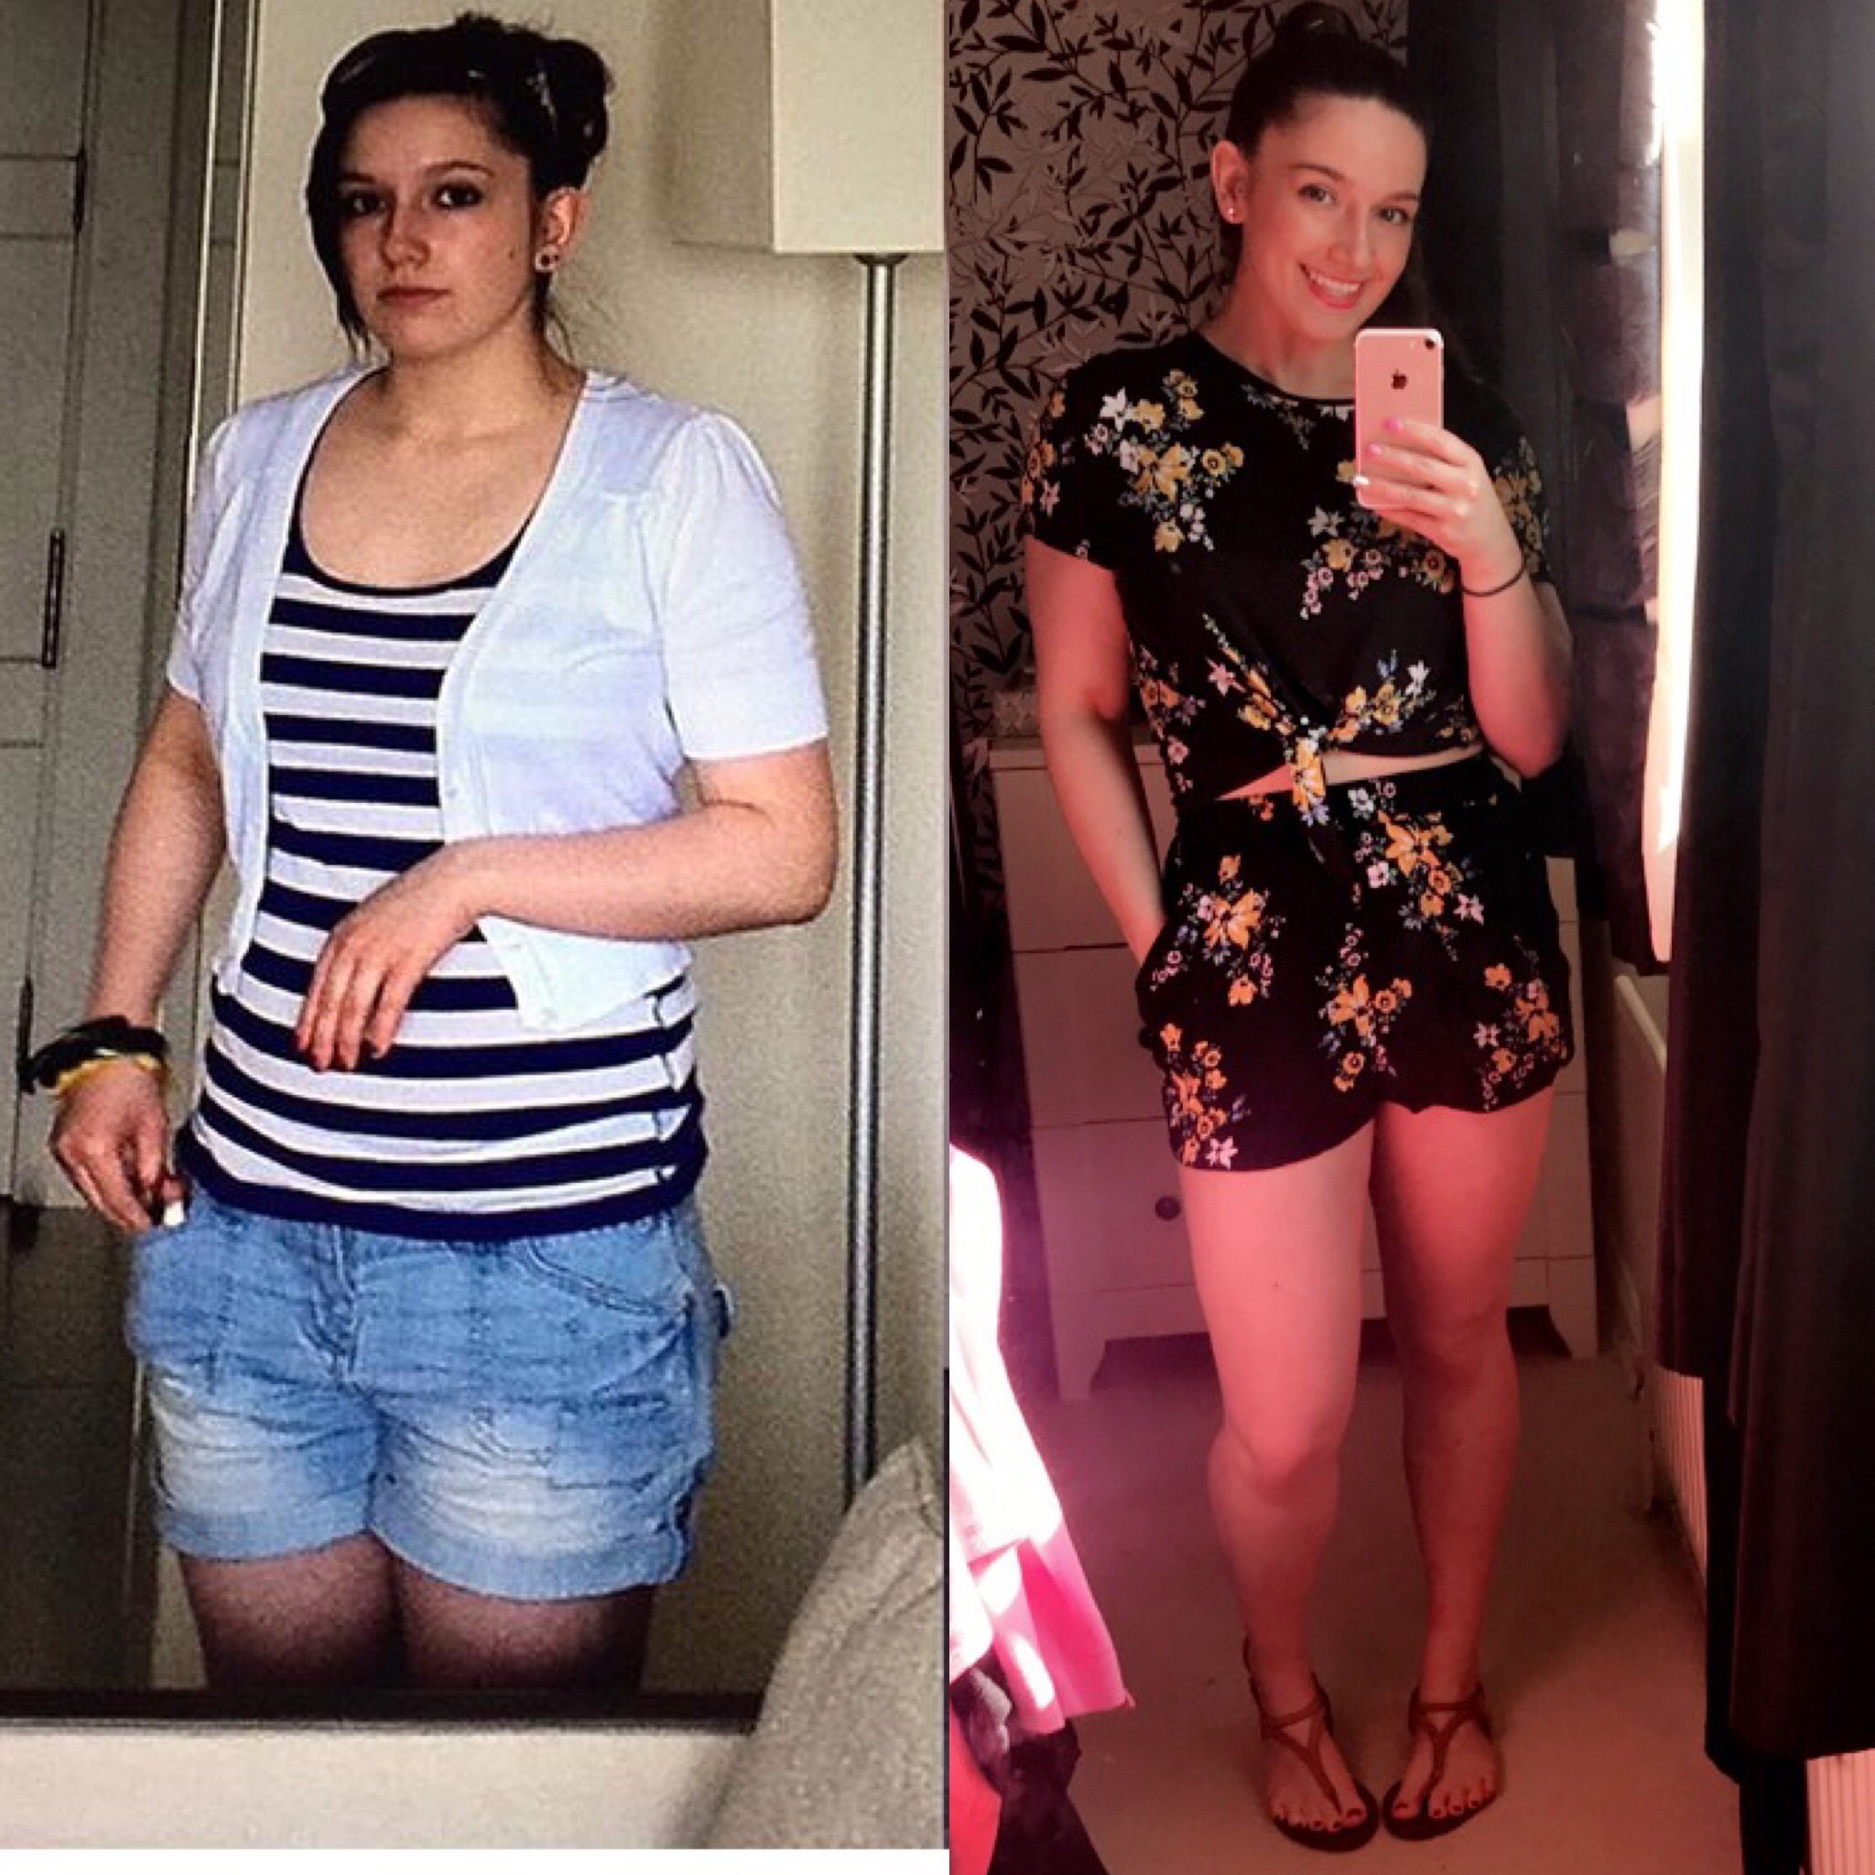
Two different body compositions and the same weight in both pictures!
Just because the scales or your weight doesn’t move, it doesn’t mean you aren’t progressing!
You have to keep trusting in the process!
The better you do with all the small things then lead to the bigger things which is why the consistency is going to get you the results!
Be patient, keep going and put your trust in me to get you there!
Keep working hard guys! We’ve got this!

